Slide 1
Some recent attacks

Slide 2
Assignment questions
Equifax, a credit reporting agency, was hacked and the records of 143 (145.5) Million Americans have been compromised. These are especially sensitive records because they include credit information as well as personal identification.
Draw a sequence diagram describing this attack. Show clearly the possible misuses of information. Find information in the Internet and indicate your sources (URLs).
Analyze critically why this attack was possible; that is, vulnerabilities in the system.
Show how the attack could have been prevented, indicating policies and mechanisms that could have stopped or mitigated the attack.

Slide 3
Context
To fully understand an attack we need to analyze the context of the hacked institution, its assets, and types of management people.
They offer credit and demographic related data and services to business, and they sell credit monitoring and fraud-prevention services directly to consumers.
Equifax is an old institution and they evolved from using paper records to computer and to the Internet. It seems that their managers are not up to date in technology and based on their past record they don’t seem to care much about their record holders.
This explains the use of unqualified technical people, lack of policies to protect their information, and general attitude about their record holders, who are not really their customers, they are their product.
Equifax was the subject of more than 57,000 consumer complaints to the Consumer Financial Protection Bureau from October 2012 to September 17, 2017 with most complaints relating to incomplete, inaccurate, outdated, or misattributed information held by the company.
For further context, see Schneier’s analysis in next slide.

Slide 4
On the Equifax data breach Bruce Schneier https://www.schneier.com/blog/archives/2017/09/on_the_equifax_.html
Last Thursday, Equifax reported a data breach that affects 143 million US customers, about 44% of the population. It's an extremely serious breach; hackers got access to full names, Social Security numbers, birth dates, addresses, driver's license numbers -- exactly the sort of information criminals can use to impersonate victims to banks, credit card companies, insurance companies, and other businesses vulnerable to fraud.
Many sites posted guides to protecting yourself now that it's happened. But if you want to prevent this kind of thing from happening again, your only solution is government regulation (as unlikely as that may be at the moment).
The market can't fix this. Markets work because buyers choose between sellers, and sellers compete for buyers. In case you didn't notice, you're not Equifax's customer. You're its product.
This happened because your personal information is valuable, and Equifax is in the business of selling it. The company is much more than a credit reporting agency. It's a data broker. It collects information about all of us, analyzes it all, and then sells those insights.
Its customers are people and organizations who want to buy information: banks looking to lend you money, landlords deciding whether to rent you an apartment, employers deciding whether to hire you, companies trying to figure out whether you'd be a profitable customer -- everyone who wants to sell you something, even governments.
Schneier: If you don't like how careless Equifax was with your data, don't waste your breath complaining to Equifax. Complain to your government.

Slide 5
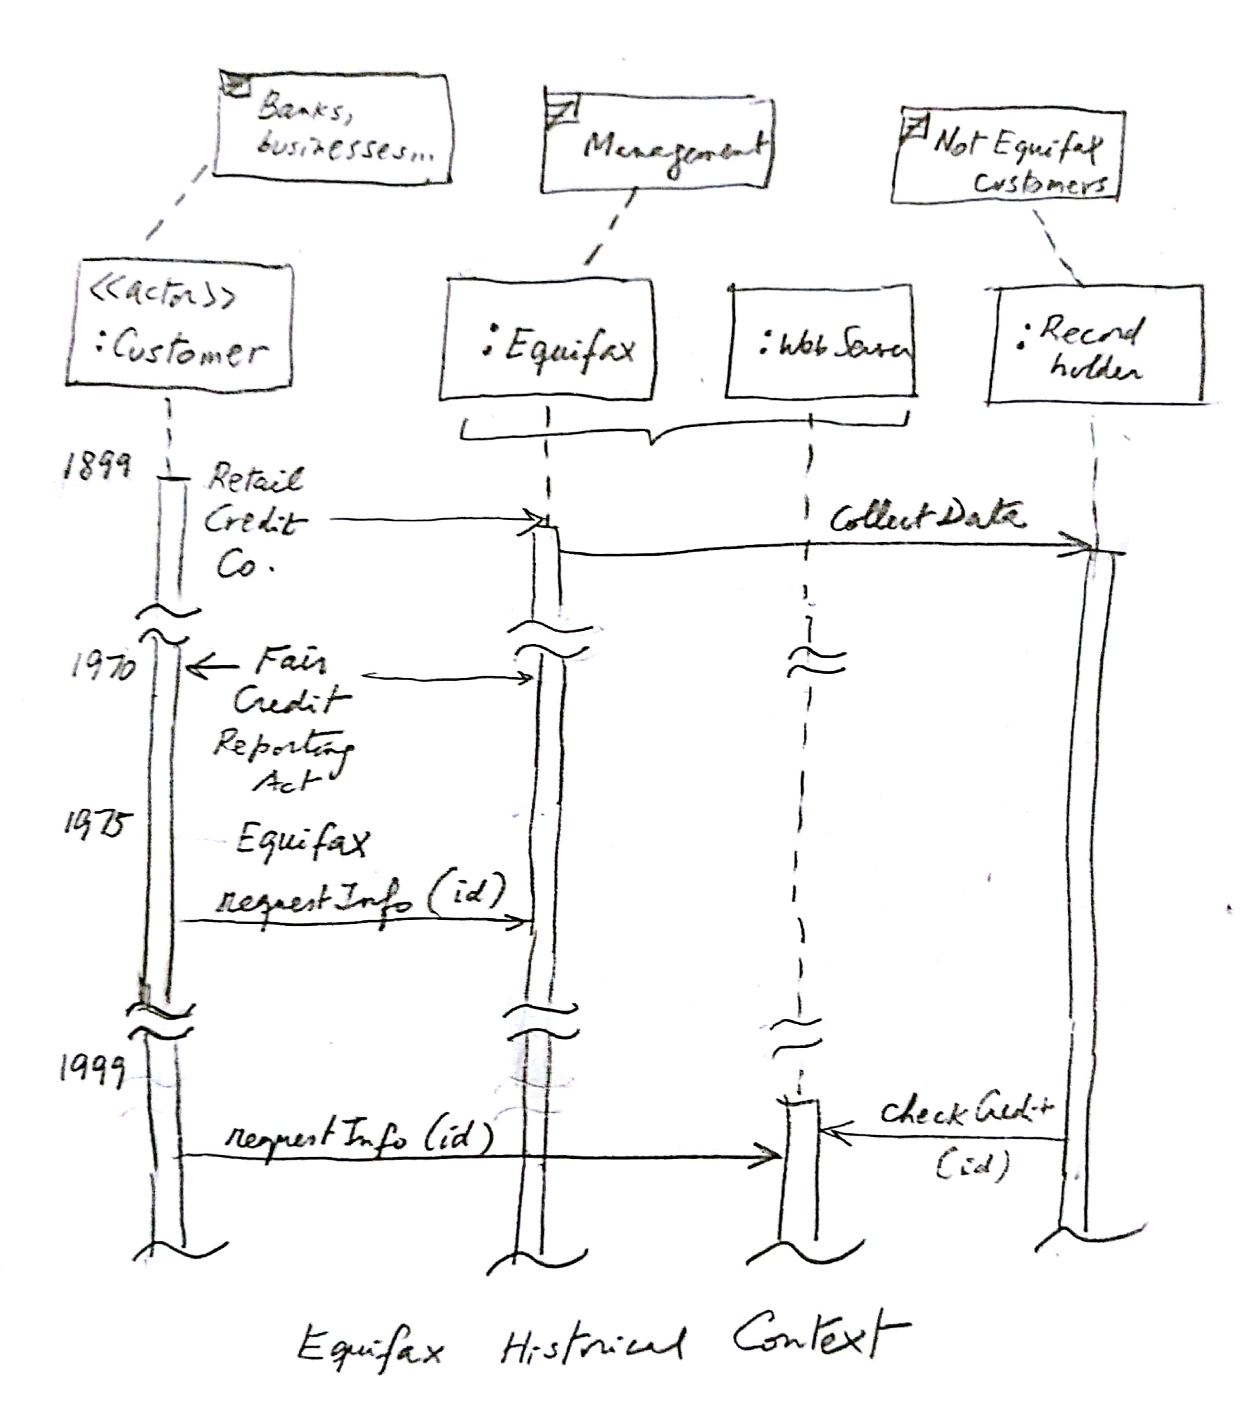

Slide 6
Fair Credit Reporting Act
The, 15 U.S.C. § 1681 (“FCRA”) is U.S. Federal Government legislation enacted to promote the accuracy, fairness, and privacy of consumer information contained in the files of consumer reporting agencies.
It was intended to protect consumers from the willful and/or negligent inclusion of inaccurate information in their credit reports.
To that end, the FCRA regulates the collection, dissemination, and use of consumer information, including consumer credit information.
Together with the Fair Debt Collection Practices Act ("FDCPA"), the FCRA forms the foundation of consumer rights law in the United States. It was originally passed in 1970, and is enforced by the US Federal Trade Commission, the Consumer Financial Protection Bureau and private litigants.

Slide 7
The attacks
The next two slides show the attack sequence, the third slide combines the other two for better perspective.
Note that we need to include the people involved because they are participating in the attack as attackers or victims.
The diagrams are complemented with numbered notes that explain some points in more detail.

Slide 8
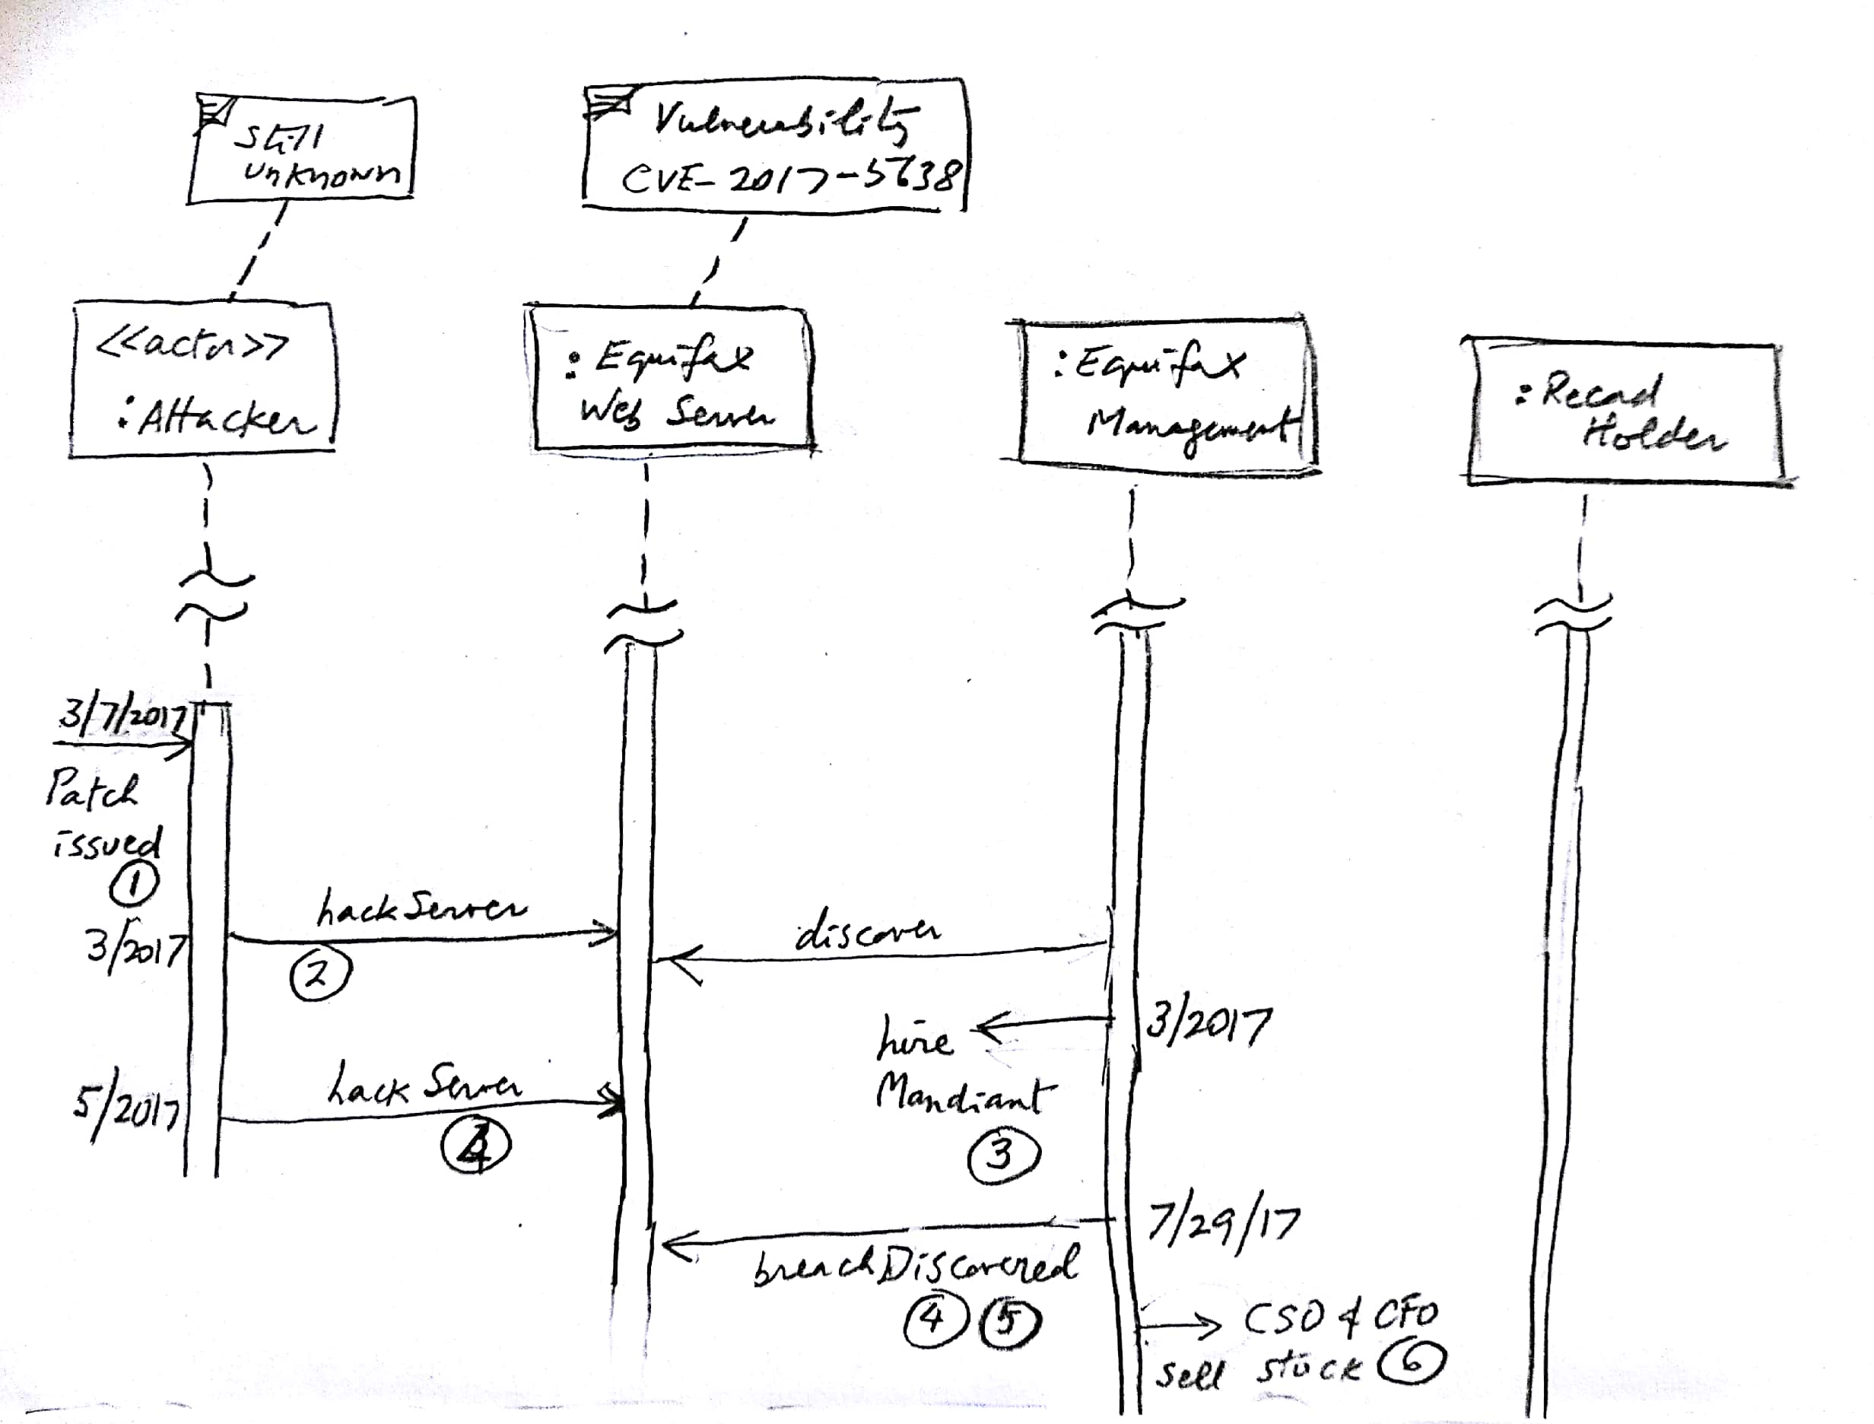

Slide 9
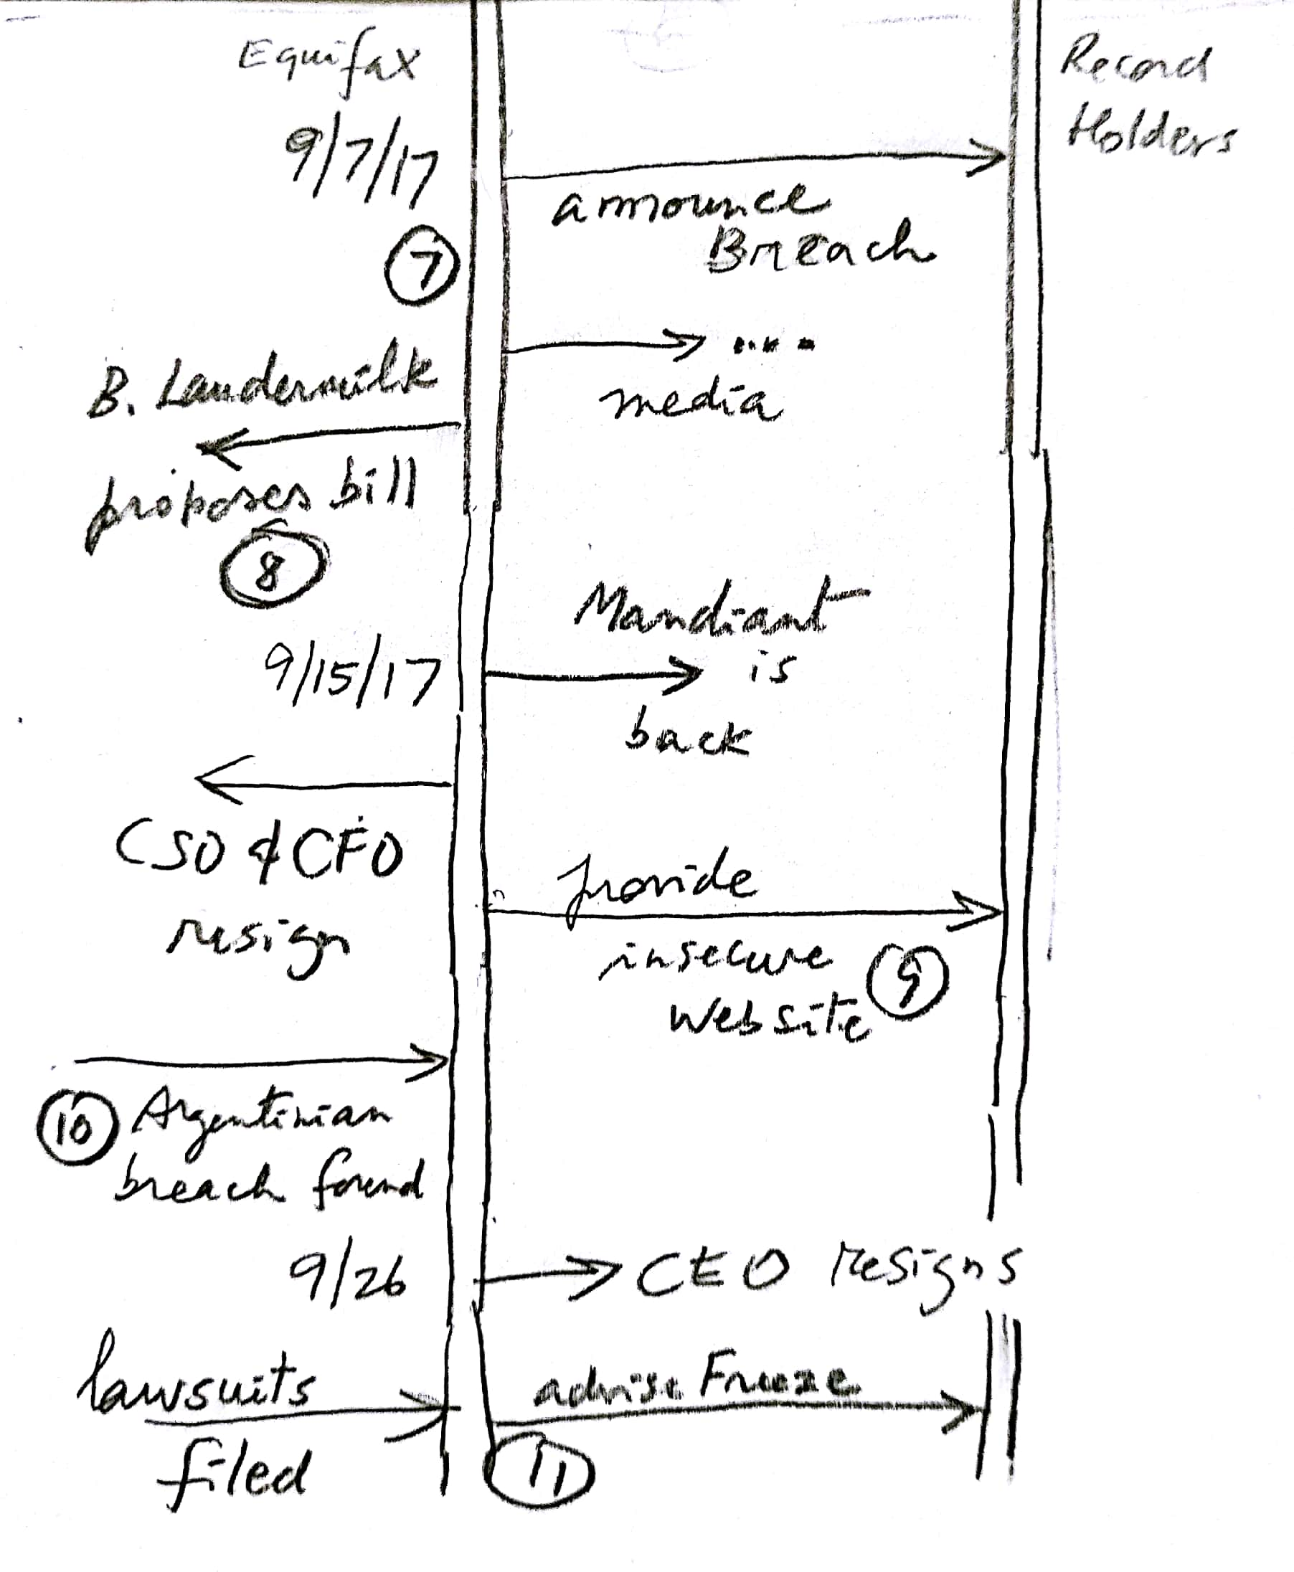

Slide 10
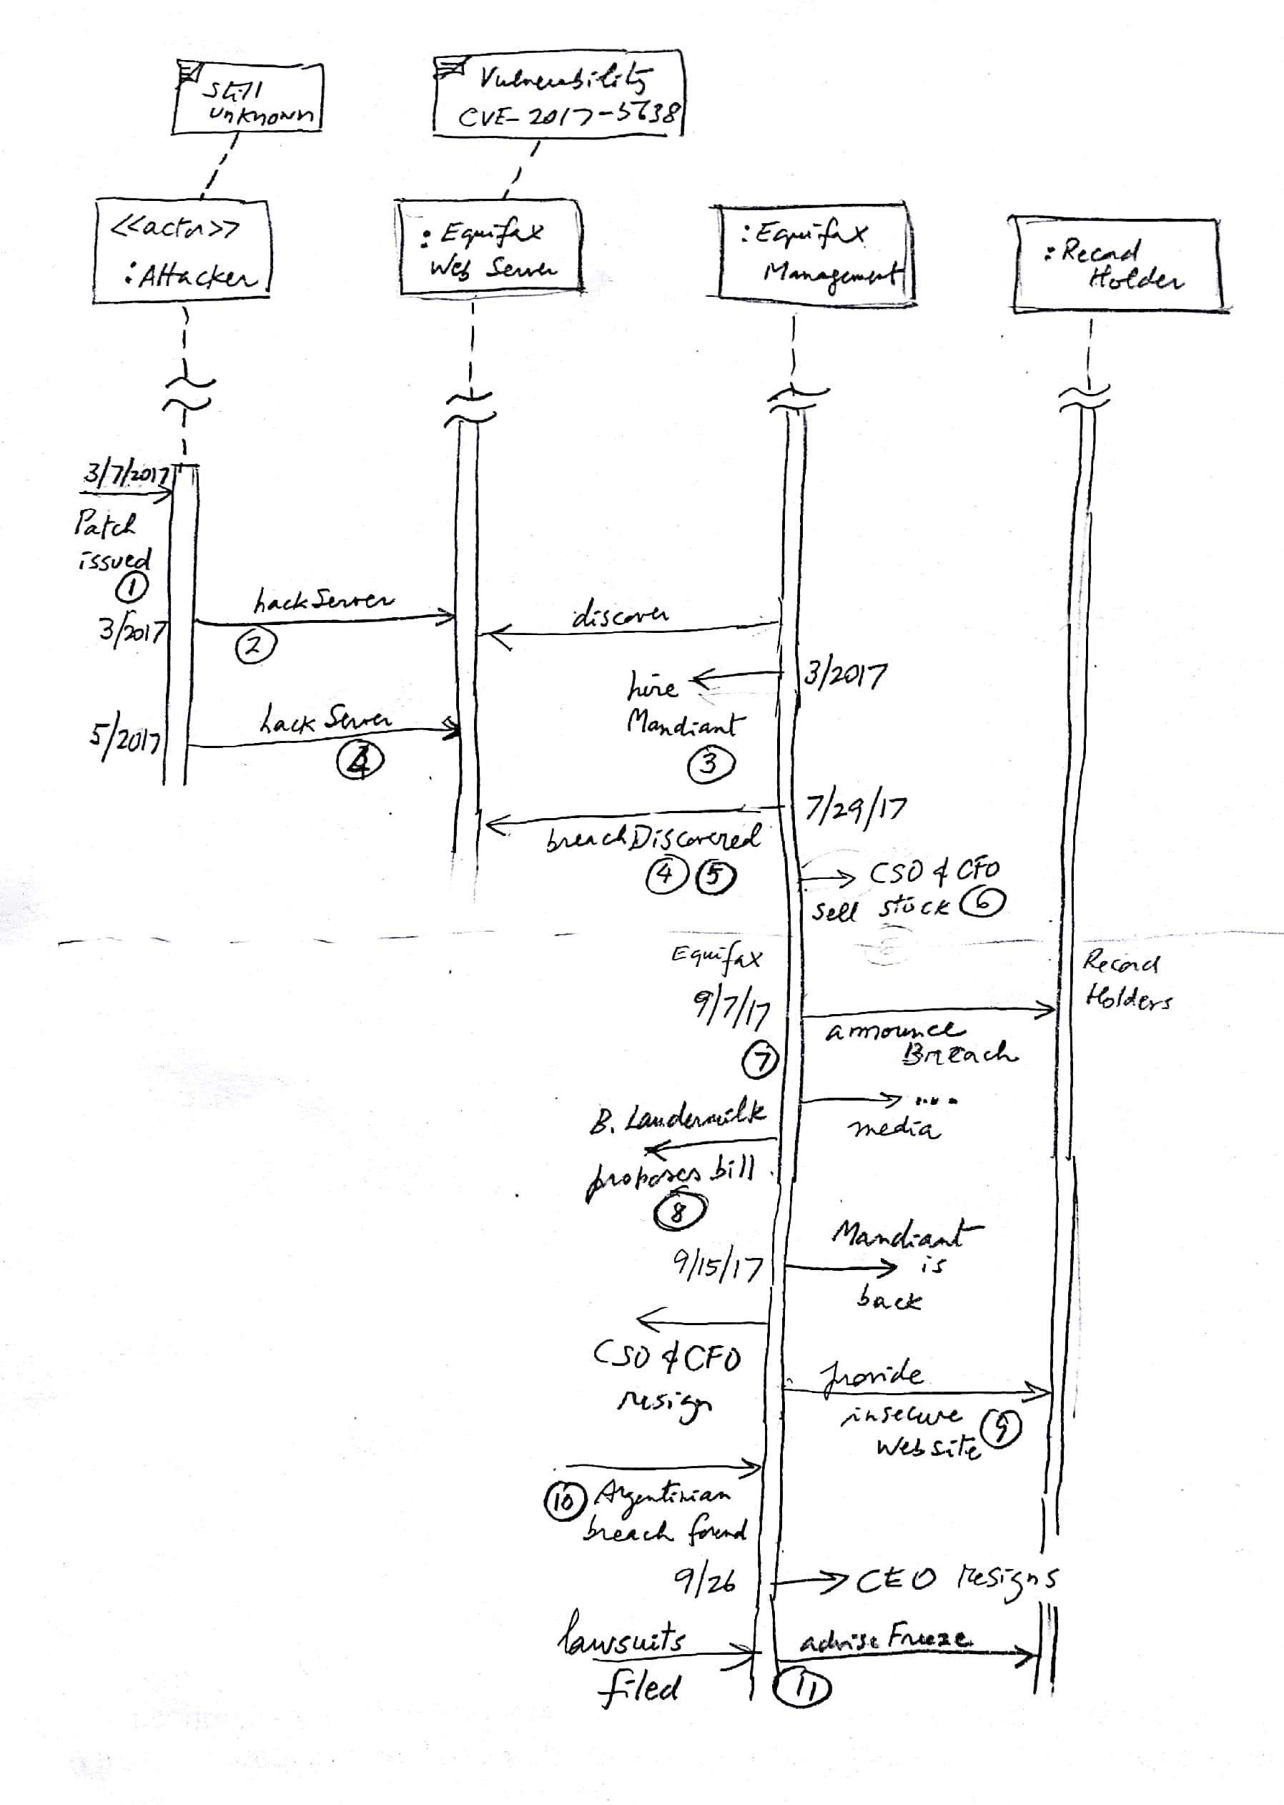

Slide 11
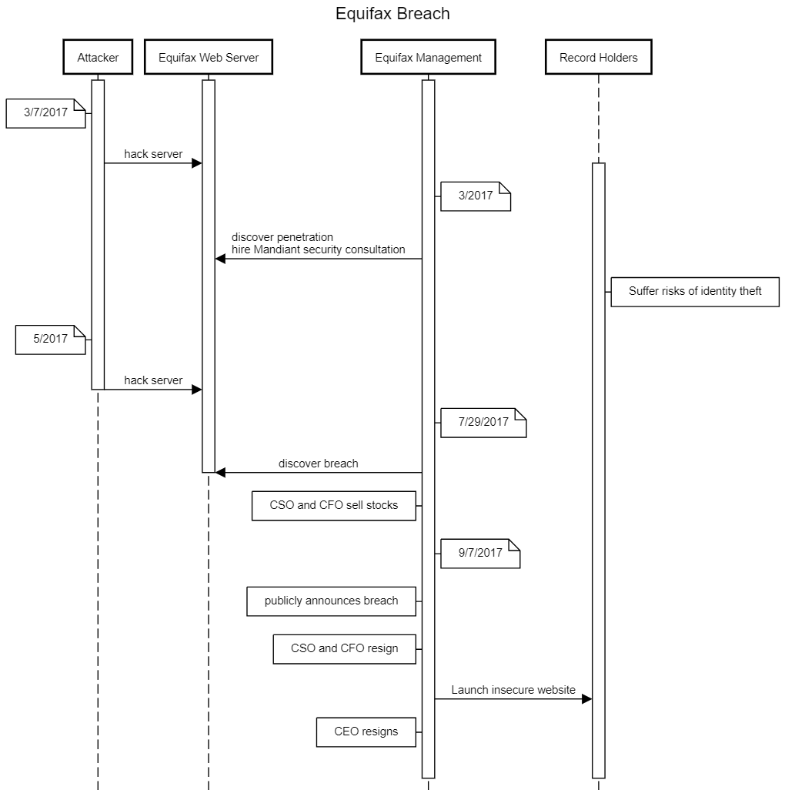

Slide 12
Notes
This and earlier patches were not applied
Equifax said that the earlier intrusion was unrelated to the recent breach but did not offer any details about the information that may have been stolen, or how many people may have been affected. This intrusion may have been carried out by the same party who breached their computer systems again in May. According to Bloomberg, Equifax enlisted Mandiant to assist in investigating the March attack. The same cybersecurity firm was hired following the May-July breach.
Mandiant is an American cybersecurity firm. It rose to prominence in February 2013 when it released a report directly implicating China in cyber espionage. On December 2013, Mandiant was acquired by FireEye.
The data breached included first and last names, SSNs, birth dates, addresses, and more in some cases (credit card numbers, driver licenses). 143 M of records were compromised in the US plus more in the UK, Canada, and Argentina.
Very harmful to record holders (loss of credit, monetary damages, annoyance)

Slide 13
Notes II
6. It was also revealed that three Equifax executives (including the CSO and the CFO)sold $1.8 M of their personal holdings of company shares days after Equifax discovered the breach but more than a month before the breach was made public. The company said the executives "had no knowledge that an intrusion had occurred at the time they sold their shares”. I guess they were just clairvoyant.
7.Other holes were found, including unpatched XSS vulnerabilities, reported to Equifax more than a year ago, and the lack of many basic protections.
8. Congressman B. Laudermilk introduced a bill to reduce consumer protection including capping potential damages in a class action suit to $500,000 regardless of size or amount of loss. It produced outrage and he delayed it (but did not give up, Equifax has given money to him in the past).

Slide 14
Notes III
9. Equifax offered a website (https://www.equifaxsecurity2017.com) for consumers to learn whether they were victims of the breach. Security experts quickly noted that the website had many traits in common with a phishing website: it was not hosted on a domain registered to Equifax and it had a flawed TLS implementation.
10. Brian Krebs revealed that an Argentinian arm of Equifax had left private data from approximately 14,000 consumers, and more than 100 staff members, openly available.
11. Numerous lawsuits have been filed against Equifax. In one suit the law firm Geragos & Geragos has indicated they would seek up to $70 billion in damages, which would make it the largest class-action suit in US history.
Numerous media outlets advised consumers to request a credit freeze to reduce the impact of the breach

Slide 15
Q2 Vulnerabilities
V1. A CSO without technical knowledge or very lazy. Their CSO had a degree in music and apparently no knowledge of security.
V2. After they were hacked in March they used a security firm but still did not patch anything. A clear failure of the CSO.
V3. They were told of XSS and the CVE-2017-5638 Apache Struts vulnerability and given patches. They did not apply them. Again, this is responsibility of the CSO.
V4. The breach was discovered on July 29 but only announced on September 7. This gave time to the attackers to hurt the record holders. This is responsibility of the CEO.
V5. They provided a web site for record holders to check their accounts but this site was insecure, exposing their users to further attacks
V6. There were other vulnerabilities like no secure system design, no authorization in the management interface, use of open source software in a security-critical application (see discussion board).

Slide 16
Possible defenses to a similar attack
V1-3 and V6. Have a competent CSO. She should have implemented a systems design for security, a plan to keep aware of vulnerabilities and fix them, and a recovery plan.
V4. Get an ethical CEO. Delaying the announcement of the breach was very harmful to the record holders.
V5. Get a competent and responsible management and security team. They should have not used an insecure web site to let users check their accounts.
V1-3. Free, open-source software is not intended for high security applications like this one. This (and the other aspects above) indicates an emphasis on saving money and lack of concern for their subjects. There are many products in the market that can be used to build a secure system.

Slide 17
References
https://nakedsecurity.sophos.com/2017/09/08/equifax-data-breach-what-you-need-to-know/?utm_source=Naked+Security+-+Sophos+List&utm_campaign=0106671f28-naked%252Bsecurity&utm_medium=email&utm_term=0_31623bb782-0106671f28-455135885
https://en.wikipedia.org/wiki/Equifax
https://www.wired.com/story/equifax-breach-no-excuse/
Fox-Brewster, T. (2017, September 14). How Hackers Broke Equifax: Exploiting A Patchable Vulnerability. https://www.forbes.com/sites/thomasbrewster/2017/09/14/equifaxhack-the-result-of-patched-vulnerability/#4a0e26395cda
http://www.securityweek.com/equifax-shares-more-details-about-breach
https://www.nytimes.com/2017/09/14/business/equifax-hack-what-we-know.html?mcubz=1&_r=0

Slide 18
Epilogue (from SANS): Equifax CEO to Appear Before House Committee (September 29 & October 3, 2017)
Former Equifax CEO Richard F. Smith is scheduled to appear before the US House Committee on Energy and Commerce Subcommittee of Digital Commerce and Consumer Protection on Tuesday, October 3, 2017. In his prepared testimony, Smith outlines the series of errors that led to the breach, including the company's failure to patch systems against the Apache Struts vulnerability earlier this year.
[John Pescatore] Lessons: (1) ammunition in driving change in IT operations in basic configuration and vulnerability management hygiene: (2) lessons learned in why mitigation must be applied until (1) happens; and (3) why continuous monitoring of critical systems is a must, especially when (1) and (2) haven't happened.
[William Hugh Murray] Like the government, the credit bureaus have been entrusted with more information than they are capable of protecting. We need to transfer the responsibility for accuracy from the subject of the information to those trading in it. It would make them liable for damages resulting from negligence on their part.
--It has been a year on Sept. 14 since this happened. There are still no regulations. Freeze your credit accunts in Experian, Trans Union, and Equifax.

Slide 19
GAO Report on Equifax Breach (SANS NewsBites Vol. 20 Num. 074, September 17, 2018)
A report from the US government Accountability Office (GAO) on the Equifax breach found that the company had to look at the attackers’ database queries to determine exactly what information had been compromised. (The breach affected more than 165 million people worldwide.) The report found that “while Equifax had installed a device to inspect network traffic for evidence of malicious activity, a misconfiguration allowed encrypted traffic to pass through the network without being inspected.” The misconfiguration was due to an expired certificate.
Editor's Note [Pescatore] The GAO report mostly rehashes old news about last year’s Equifax breach, but in the section about looking at the reactions of government agencies who are Equifax customers had a telling quote: “Representatives of IRS, SSA, and USPS noted that they responded to the breach independently of other agencies, because they said it was unclear whether any single federal agency had responsibility for coordinating government actions in response to a breach of this type in the private sector.” This points out a huge, gaping hole in the US Federal Government approach to supply chain security – didn’t anyone at DHS or NIST read the news and say “We need to proactively find out all government customers of Equifax and have a coordinated response”?? [Murray] This report simply supports the conclusions already reached that this breach was caused by the failure of Equifax to adhere to what should be essential practices, not to say basic hygiene, to protect sensitive personal information about its subjects. This information represented the “stock in trade” of Equifax and its competitors. Moreover, its compromise was bound to result in an increase in credit application fraud.
[Williams] After reading this report, I think a case can be made that the Equifax breach was a supply chain issue. Equifax didn't add a systems admin to an email list about Struts vulnerabilities, but it also failed to identify the vulnerability in its vulnerability scans, even after the attackers had compromised the system. But if Struts is not deployed in the web root, an analyst must configure the scanner to the Struts URLs to be successful. This combination of failures would seem to imply that Equifax was simply unaware that this system was using Struts at all.

Slide 20
Typical assignment errors
A verbose essay merging the three questions. Answers should be separated, itemized, precise, and concise.
Ignoring the actions of management and other actors. Security is a whole system problem, not just a technical problem.
Merging customers with record holders
Confusing vulnerabilities with events in the attack.
Giving general solutions such as: use authentication, encrypt the database,… We do not know their architecture so for now we can only say “build a secure architecture”. More specific remedies are better: “have a plan for fixing known vulnerabilities”.

Slide 21
Common vulnerabilities and exposures (CVE)
Printer-Friendly View
CVE-ID
CVE-2017-5638 | Learn more at National Vulnerability Database (NVD) • Severity Rating • Fix Information • Vulnerable Software Versions • SCAP Mappings
Description
The Jakarta Multipart parser in Apache Struts 2 2.3.x before 2.3.32 and 2.5.x before 2.5.10.1 has incorrect exception handling and error-message generation during file-upload attempts, which allows remote attackers to execute arbitrary commands via a crafted Content-Type, Content-Disposition, or Content-Length HTTP header, as exploited in the wild in March 2017 with a Content-Type header containing a #cmd= string.

Slide 22
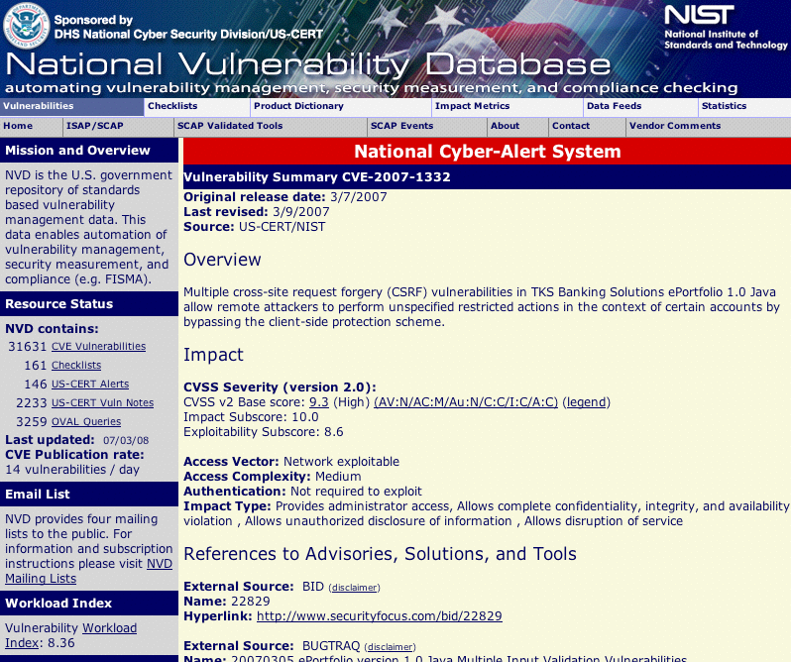

Slide 23
Common Vulnerability Scoring System (CVSS) https://www.first.org/cvss/
It provides a way to capture the principal characteristics of a vulnerability and produce a numerical score reflecting its severity.
The numerical score can then be translated into a qualitative representation (such as low, medium, high, and critical) to help organizations properly assess and prioritize their vulnerability management processes.
CVSS is a published standard used by organizations worldwide, and the SIG's mission is to continue to improve it.
The National Vulnerability Database uses its scores.
They have a set of illustrative examples.

Slide 24
Open Web Application Security Project (OWASP) www.owasp.org
OWASP is an international organization and the OWASP Foundation supports OWASP efforts around the world.
OWASP is an open community dedicated to enabling organizations to conceive, develop, acquire, operate, and maintain applications that can be trusted.
All of the OWASP tools, documents, forums, and chapters are free and open to anyone interested in improving application security.
We advocate approaching application security as a people, process, and technology problem because the most effective approaches to application security include improvements in all of these areas.
Our freedom from commercial pressures allows us to provide unbiased, practical, cost-effective information about application security. OWASP is not affiliated with any technology company, although we support the informed use of commercial security technology. Similar to many open-source software projects, OWASP produces many types of materials in a collaborative and open way

Slide 25
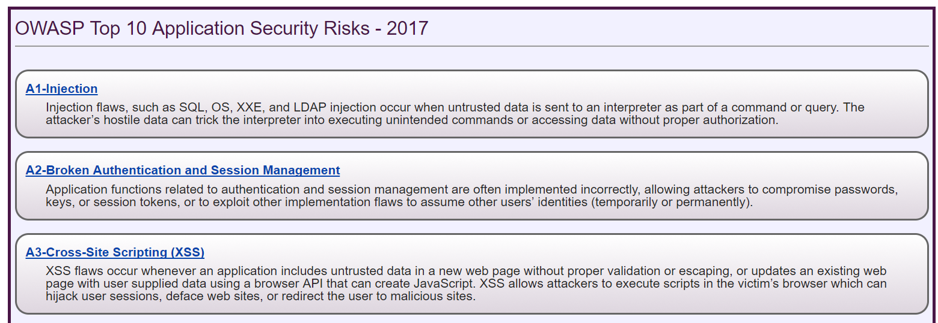

Slide 26
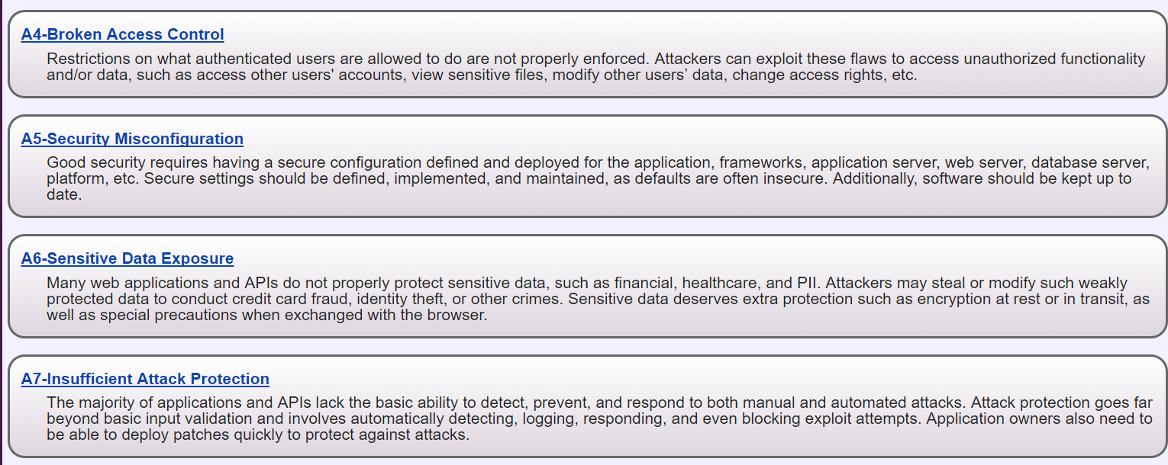

Slide 27
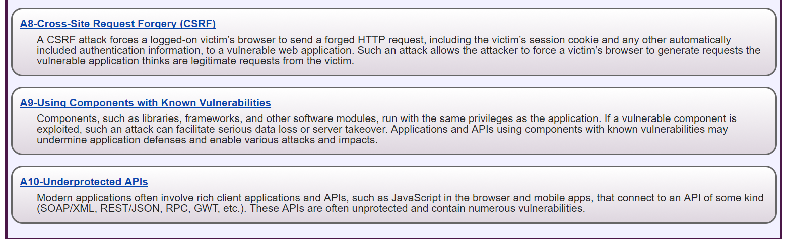

Slide 28
Confusions
OWASP and NVD mix vulnerabilities with threats. They describe risks, something in between.
When discussing a threat one should consider the vulnerabilities that make possible for the threat to launch an attack but often more important than fixing a vulnerability (usually hard to do) is to stop or mitigate the attack by interrupting its sequence of steps.
That is the idea of the misuse patterns, that describe how an attack is performed

Slide 29
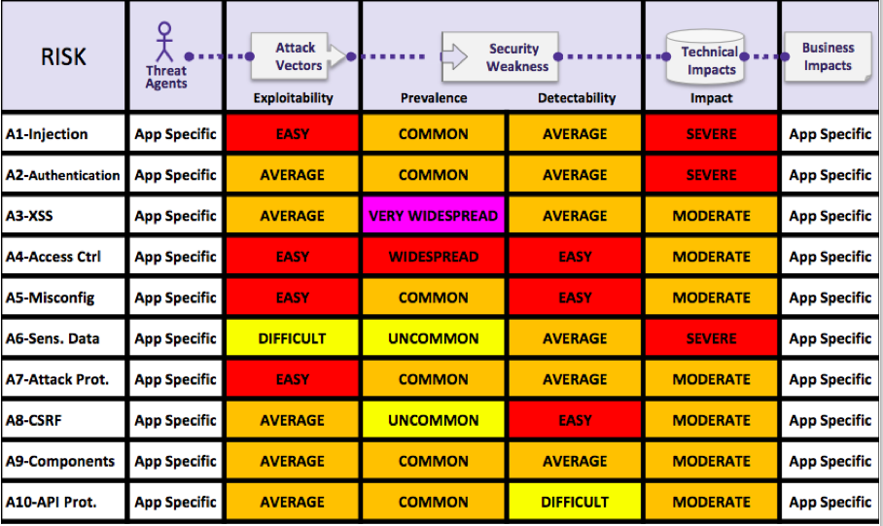
Details about Risk Factors

Slide 30
Other attacks: Anthem, World Banking, Yahoo, Sony
[Ant15] Mathews, Anna Wilde. "Anthem: Hacked Database Included 78.8 Million People." The Wall Street Journal. Dow Jones & Company, 2015. Web. 29 Dec. 2016.
[Ant16] "Insurance giant Anthem hit by massive data breach." CNNMoney. Cable News Network, n.d. Web. 29 Dec. 2016.
[WBk16] Corkery, Michael. "Hackers’ $81 Million Sneak Attack on World Banking." The New York Times. The New York Times, 2016. Web. 29 Dec. 2016.
[Yah16a] "Marissa Mayer declined to reset Yahoo users’ passwords 2 years ago." Naked Security. N.p., 2016. Web. 29 Dec. 2016. <https://nakedsecurity.sophos.com/2016/09/28/marissa-mayer-declined-to-reset-yahoo-users-passwords-2-years-ago/?utm_source=Naked%2BSecurity%2B-%2BSophos%2BList&%3Butm_campaign=b92c449beb-naked%252Bsecurity&%3Butm_medium=email&%3Butm_term=0_31623bb782-b92c449beb-455135885>.
[Yah16b] Perlroth, Nicole, and Vindu Goel. "Defending Against Hackers Took a Back Seat at Yahoo, Insiders Say." The New York Times. The New York Times, 2016. Web. 29 Dec. 2016.
[Yah16c] https://www.facebook.com/CNBC. "How Yahoo's massive data breach stacks up with the worst of all time." CNBC. CNBC, 2016. Web. 03 Jan. 2017. <http://www.cnbc.com/2016/09/22/yahoo-data-breach-is-among-the-biggest-in-history.html>.
[Yah17] https://arstechnica.com/tech-policy/2017/03/fbi-hints-that-hack-of-semi-privileged-yahoo-employee-led-to-massive-breach/
[Sony] http://en.wikipedia.org/wiki/Sony_Pictures_Entertainment_hack
http://www.vanityfair.com/hollywood/2015/02/sony-hacking-seth-rogen-evan-goldberg
http://www.businessinsider.com/how-the-hackers-broke-into-sony-2014-12

Slide 31
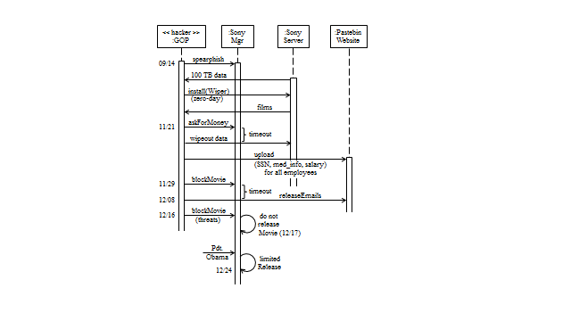
Sony attack sequence

Slide 32
Was this unavoidable?
Use of zero-day attack could not have been protected
No physical control, hackers got into building
Phishing can be stopped by user training
Database servers should have had authentication and authorization systems and have critical fields encrypted
Password files should have been encrypted
Mail servers should have had all emails encrypted
No filter of mail in the firewall (mail to many places from hackers)
No defense in depth, everything collapses after the hackers get in

Slide 33
Comparison with Equifax breach
Also very incompetent managers, the CEO was fired too, they had no CSO
Damage was much smaller, reaching only the company itself
Their employees records were exposed. The company films were stolen, their employees emails were exposed.
Equifax obviously required a higher level of protection because they had sensitive data about many people

Slide 34
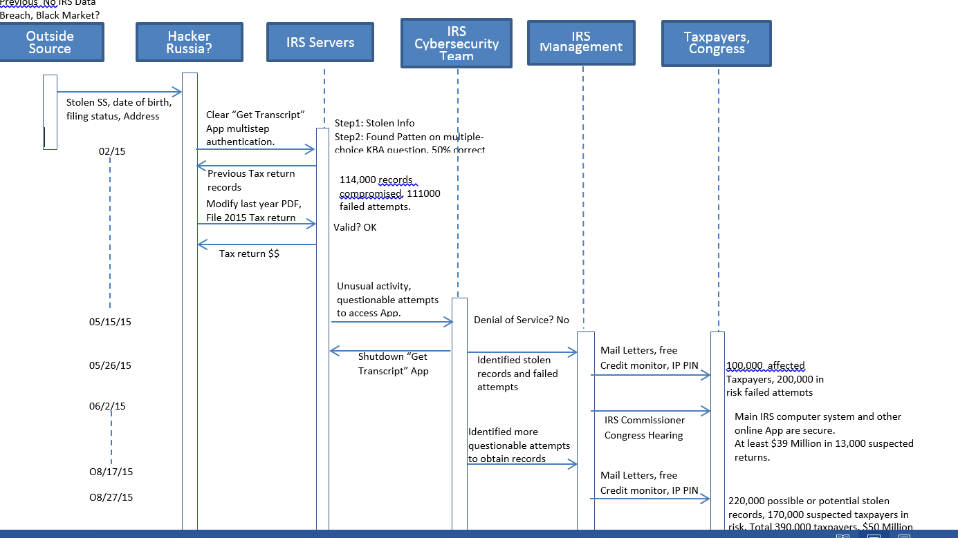

IRS attack

Slide 35
The IRS attack of 2015
More than 700,000 social security numbers and other sensitive information may have been stolen.
To access their past returns taxpayers authenticate themselves to the IRS. Passwords and secret questions are easy to get or to guess. Educate taxpayers.
The IRS said hackers used personal information gathered from other online sources - like bank accounts - to answer personal identity questions on the "Get Transcript" forms. One possible culprit is the IRS-approved tax preparers. According to an audit conducted by the non-profit online trust alliance, six out of 13 IRS-approved companies failed at providing adequate security to customers.
Use better authentication, i.e. two or multifactor authentication with different media. Hackers cannot get individuals’ returns if they fail this step.

Slide 36
Some multi-factor authentications are weak
The IRS incident is but the latest example of a hack that could have been prevented with two-factor authentication (TFA): combining something you know (a password or PIN) with something you have (a phone or security token).
Most hacks have involved guessing weak passwords using a dictionary attack, statistical analysis, or lists of popular (and weak) passwords.
But the IRS attack exposed another flaw in common authentication schemes, reliance on personally identifiable information for access or password recovery.
The IRS attack combined a step using Name,SSN, DoB, and Filing Status with another step of personal questions selected by the taxpayers.

Slide 37
Secret questions
Although the IRS attackers appear to have gained IDs in other ways, such as purchasing a Fullz Dump, researchers atGoogle GOOGL +0.75% have discovered how easily password recovery questions can be guessed. They found answers ”contain commonly known or publicly available information, or are in a small set of possible answers for cultural reasons,” allowing the team to correctly guess challenge questions with surprising frequency. For example, there’s a one-out-of-five chance of matching an English-speaker’s favorite food (pizza) or a 12% chance of getting a Korean’s place of birth on the first try (the full research report can be found here).
Even when users attempt to spoof identity thieves it backfires. Google “found that 37% of people intentionally provide false answers to their questions thinking this will make them harder to guess. However, this ends up backfiring because people choose the same (false) answers, and actually increase the likelihood that an attacker can break in.”

Slide 38
References
http://qz.com/445233/inside-the-irss-massive-data-breach/
http://www.nextgov.com/cybersecurity/2015/08/inside-massive-irs-data-breach/119666/
http://www.irs.gov/uac/Newsroom/IRS-Statement-on-the-Get-Transcript-Application
http://www.forbes.com/sites/kurtmarko/2015/05/27/irs-hack_fido-leadership/
http://blogs.wsj.com/briefly/2015/05/27/5-questions-about-the-irs-data-breach/
http://www.irs.gov/uac/Newsroom/Get-Transcript-Application-Questions-and-Answers
http://www.irs.gov/uac/Newsroom/IRS-Statement-on-the-Get-Transcript-Application
http://www.irs.gov/uac/Newsroom/Additional-IRS-Statement-on-the-Get-Transcript-Incident
http://www.irs.gov/uac/Written-Testimony-of-Commissioner-Koskinen-on-Unauthorized-Attempts-to-Access-Taxpayer-Data-before-Senate-Finance-Committee
https://nakedsecurity.sophos.com/2015/08/18/irs-estimate-of-stolen-tax-records-balloons-to-over-300000/

Slide 39
Pentagon data leak
Unprotected Pentagon Database Stored 1.8 Billion Internet Posts By Eduard Kovacs on November 20, 2017 http://www.securityweek.com/unprotected-pentagon-database-stored-18-billion-internet-posts
Researchers have found an unprotected database storing 1.8 billion posts collected from social media services, news websites and forums by a contractor for the U.S. Department of Defense.
The data was discovered on September 6 by Chris Vickery, director of risk research at cyber resilience firm UpGuard, inside an AWS S3 storage bucket that was accessible to any user with an AWS account.
Based on the names of the subdomains storing it, the information appears to have been collected for the U.S. Central Command (CENTCOM) and the U.S. Pacific Command (PACOM), unified combatant commands of the Department of Defense.
This is not the first time UpGuard has found an unprotected AWS S3 bucket storing data belonging to a high profile organization. In the past months, the company discovered similar leaks tied to Accenture, the U.S. Republican Party, TigerSwan, Verizon, and the U.S. military.

Slide 40
Possible misuse/threat patterns
These cases are incidents, instances of attacks.
If we find commonalities between these (or other) attacks they can be converted into misuse patterns
The tables from [Uzu11] list possible threat patterns
There are also other descriptions of attacks: attack trees [Moo01], attack graphs, misuse cases [Sin08], Data Flow Descriptions

Slide 41
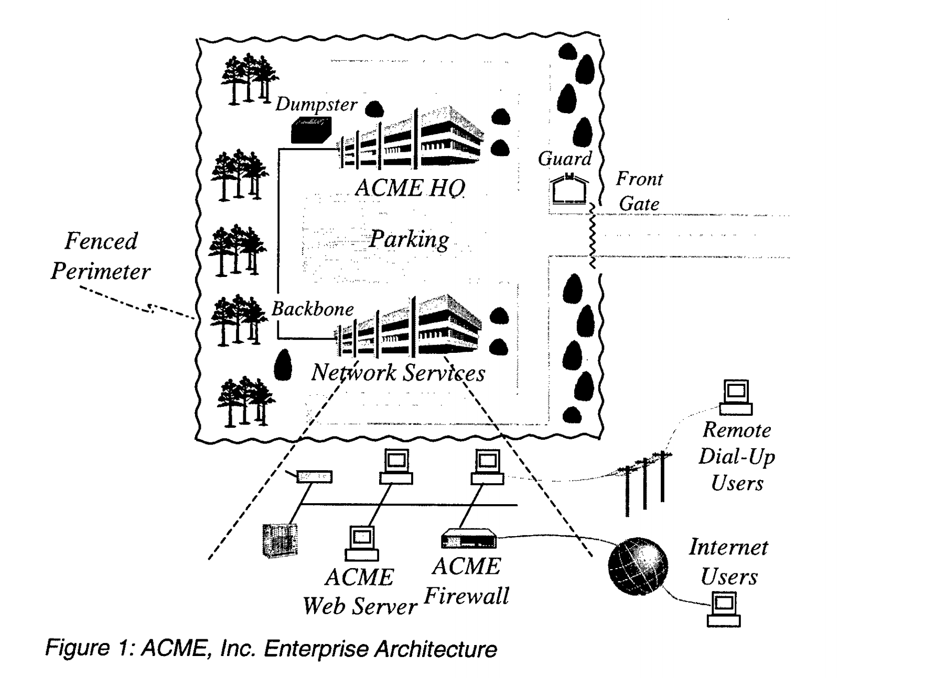

Slide 42
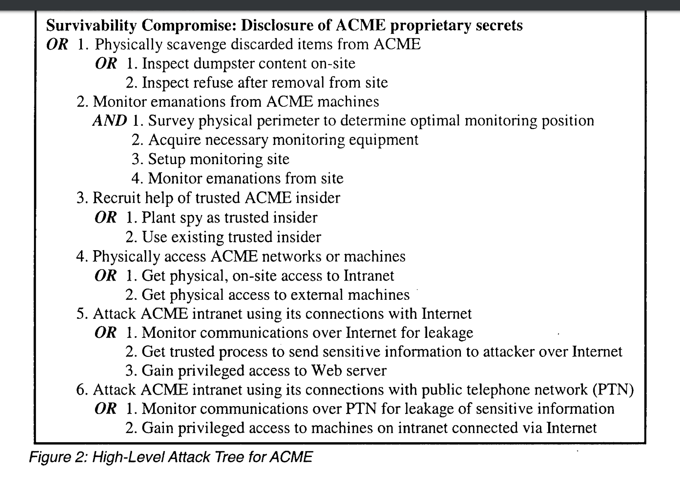

Slide 43
Attack trees
They indicate the conditions (And, Or) to have a successful attack
They do not show how the attack is performed as the threat/misuse patterns
They could be used together—an interesting subject for a project

Slide 44
Misuse cases
Use cases specify required behaviour of software and other products under development, and are essentially structured stories or scenarios detailing the normal behavior and usage of the software.
A Misuse Case highlights something that should not happen (i.e., a Negative Scenario) and the threats hence identified, help in defining new requirements, which are expressed as new Use Cases.

Slide 45
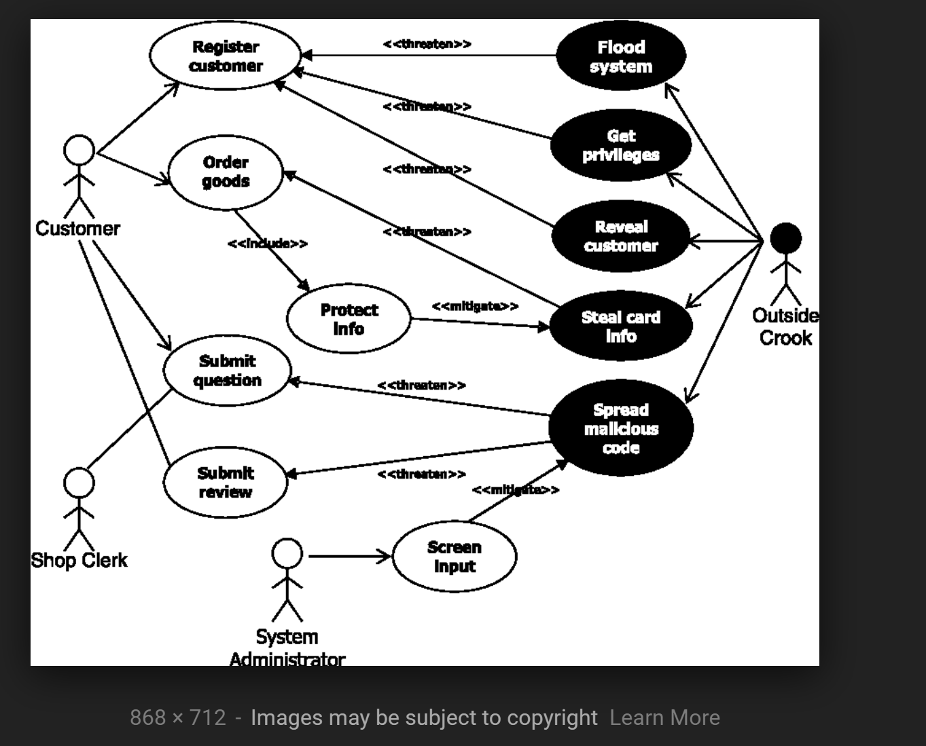
Misuse cases

Slide 46
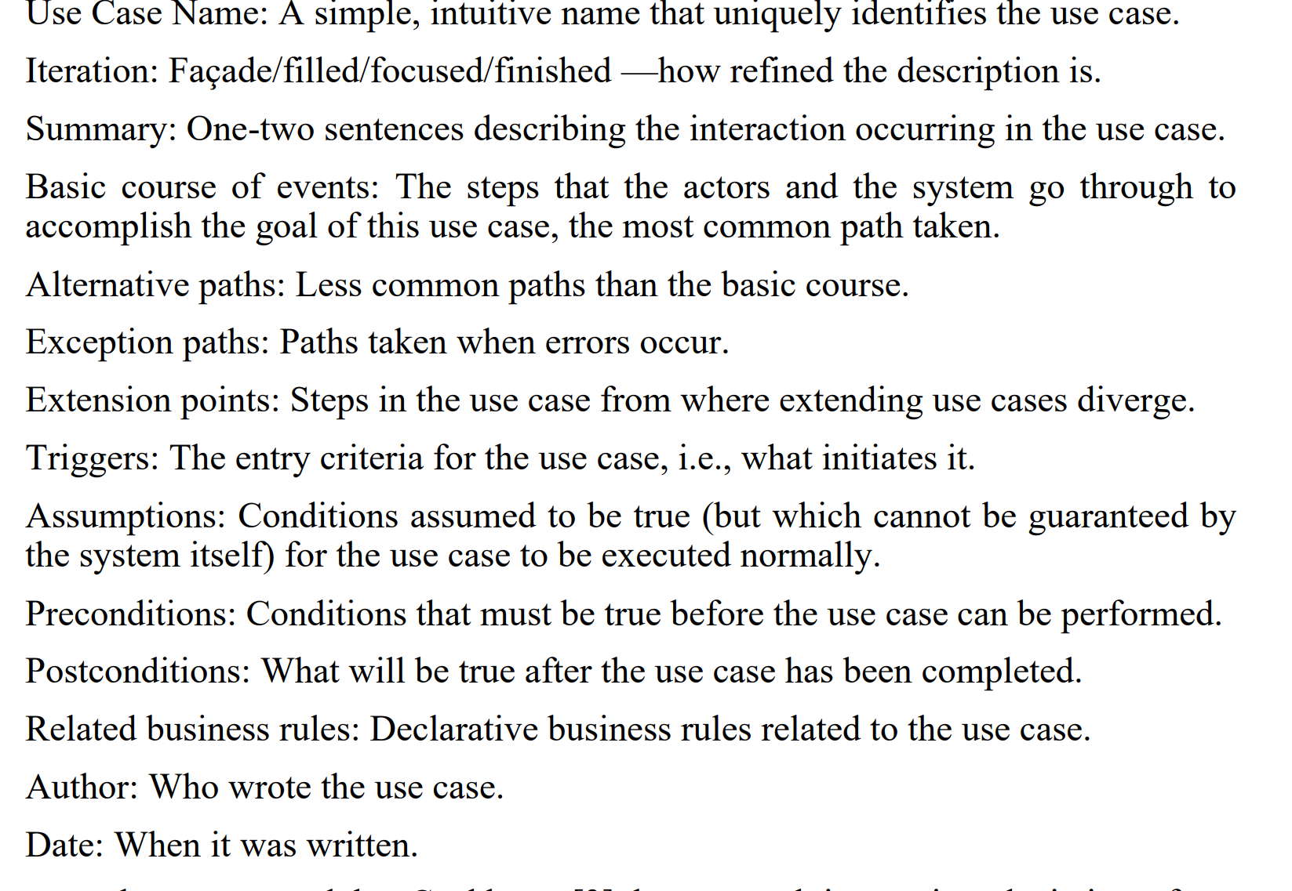

Slide 47
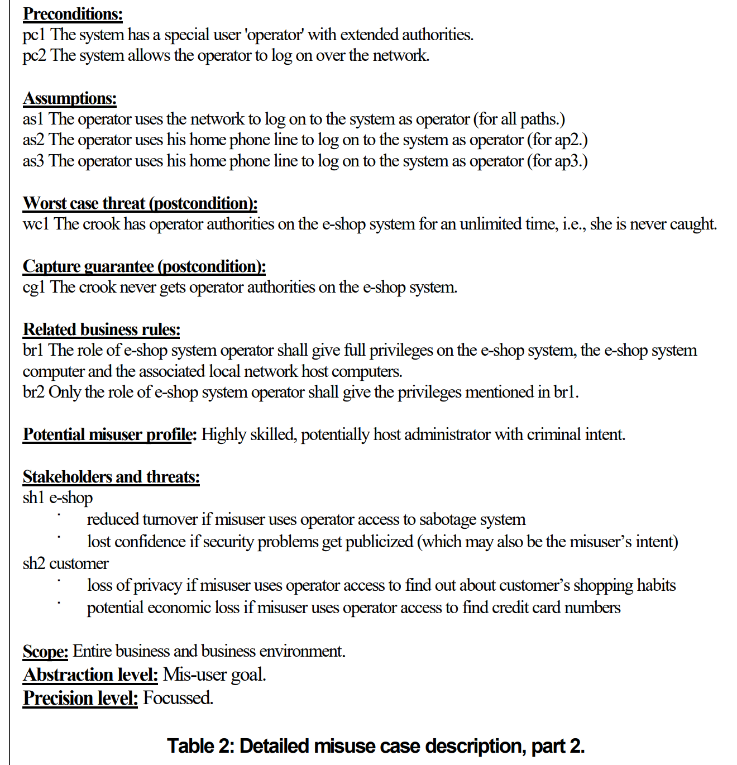

Slide 48
Assignment 1 Q1 (due Sun Oct 14)
Compare misuse cases to our way to enumerate threats (Chapter 1 in slides, Chapter 2 in notes).
No verbose descriptions
Itemize your points
Give references to support claims or arguments if the claim is yours
An example and a table are a good way to compare methods

Slide 49
Assignment 1 Q2 (due Sun Oct 14)
In my paper on tactics (attached), I say that our tactic set is “better” than the original set. How would you prove this assertion?
Indicate all possible ways you can think of or find (with references).

Slide 50
References
[Moo01] Andrew P. Moore, Robert J. Ellison, Richard C. Linger, “Attack Modeling for Information Security and Survivability”, Technical Note CMU/SEI-2001-TN-001, CMU/SEI 2001
[Sin08] G. Sindre, A.L. Opdahl, “Misuse Cases for Identifying System Dependability Threats”, J. of Inf. Privacy and Security, Volume 4, 2008 - Issue 2, 3-22
[Uzu11] A. Uzunov and E.B.Fernandez, “An Extensible Pattern-based Library and Taxonomy of Security Threats for Distributed Systems”, Special Issue on Security in Information Systems of the Journal of Computer Standards & Interfaces. 2013 http://dx.doi.org/10.1016/j.csi.2013.12.008

Slide 51
Analysis of the attack to British Airways
Magecart criminal hacking gang, who is known for web-based credit
card skimming – finding websites that don’t secure payment data forms
The attack is tailored to BA’s specific infrastructure,
mimicking BA’s site
They used a “cross-site scripting” (XSS) attack – identifying a poorly
secured web page component and injecting their own code into it to
alter a victim site’s behavior
In this case, it’s BA’s Baggage Claim Information Page, which has a
payment form
The form asks for the name, address, email, credit card number,
expiration date, and CVV (Card Verification Value code)
The hackers injected 22 lines of code to the JavaScript component
(on the BA website, prior to the attack) that processes the
aforementioned form data

Slide 52
Analysis of the Cross-site Scripting attack to British Airways ii
The attack happened between Aug 21 22:58 BST and Sept 5 21:45
BST, and 380,000 transactions were compromised (BST = British
Summer Time)
The injected code grabbed the data that customers entered into the
payment form, and sent it to the hacker-controlled server (when a
user clicked or tapped a submission button)
The hackers even paid to set up a SSL certificate for their server to
help create an air of legitimacy
The attack also impacted BA’s mobile users, because that JavaScript
component is shared by BA’s Android mobile app
The clues to why it’s a “cross-site scripting” attack: 1) BA doesn’t
store CVVs; 2) The attack happened during a very specific timeframe

Slide 53
BA Baggage Claim payment form
The attack started on
Aug 21 22:58 BST
The attack ended on
Sept 5 22:58 BST
Name
Address
Email
Credit card No.
Card exp. Date
Card CVV
Name
Address
Email
Credit card No.
Card exp. Date
Card CVV
380,000 of it
. . . . . . . . . . . . . . . . .
JavaScript component
(shared by BA’s main website
& Android mobile app)
processed by
processed by
------------------------------
22 lines injected code
------------------------------
customer data
Hacker-
Controlled
Server
(w/ SSL
Certificate)
Customer
data
BA server

Slide 54
Inside the Magecart Breach of British Airways: How 22 Lines of Code Claimed 380,000 Victims
References
How Hackers Slipped by British Airways’ Defenses
https://www.wired.com/story/british-airways-hack-detaeils/
Incident Of The Week: British Airways Breach Leaks 380K Transactions
https://www.cshub.com/attacks/news/incident-of-the-week-british-airways-breach-leaks-380k-transactions
https://www.riskiq.com/blog/labs/magecart-british-airways-breach/?
Rohini Sulatycki and Eduardo B. Fernandez, “A threat pattern for the “Cross-Site Scripting (XSS)” attack”, 22nd Conference on Pattern Languages of Programs 2015, Pittsburgh, PA, October 24-26, 2015

